Slide 1
Firefly Algorithm
[Paper ID: 22]
Indraneel Ghosh
Mohit Kriplani
Himanshu Agarwal

Slide 2
A Brief Overview
For simplicity in describing our new FireﬂireAlgorithm (FA), we now use the following idealized rules:
Attractiveness is proportional to their brightness.
The brightness of a ﬁreﬂy is aﬀected or determined by the landscape of the objective function
For minimizing we set the intensity update to -f(x) [f(x) for maximization]
Notes:
The less brighter one will move towards the brighter one.The attractiveness is proportional to the brightness and they both decrease as their distance increases. If there is no brighter one than a particular ﬁreﬂy,it will move randomly

Slide 3
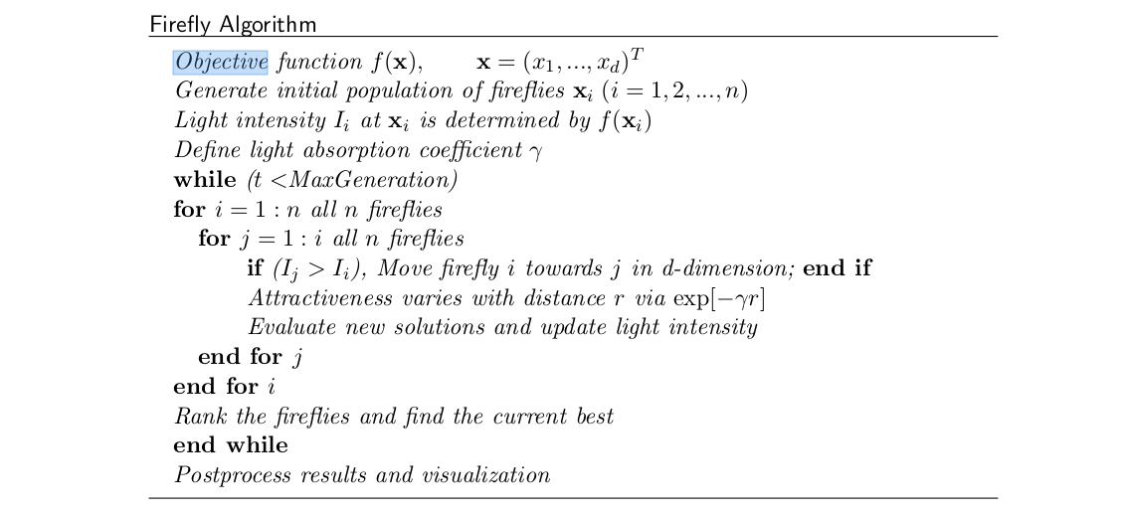
Firefly Algorithm

Slide 4
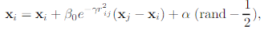
Key Points
The movement of a ﬁreﬂy is attracted to another more attractive (brighter)ﬁreﬂy which is determined by
where the second term is due to the attraction while the third term is randomization with α being the randomization parameter. rand is a random number generator uniformly distributed in [0,1]
Hyperparameters
α and β: Learning parameters or acceleration constants.β is a measure of attractiveness.
γ : Change of attractiveness, [Note: Γ = (1/ √γ) : Characteristic distance over which attractiveness(β) changes by 1/e]
Notes:
It is possible to improve the solution quality by reducing the randomness gradually.

Slide 5
Optimization Algorithms
Notes:
Add the functions and visualization and explain how they are important in the code.
12-15 slides

Slide 6
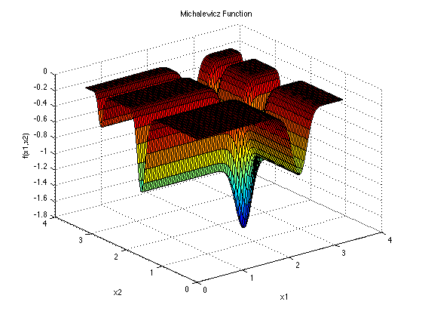
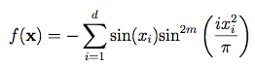
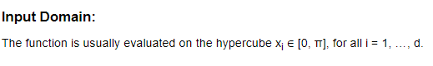

Michalewicz Function (d=16, m=10)

Slide 7
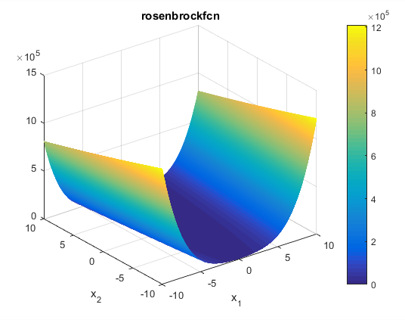
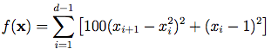
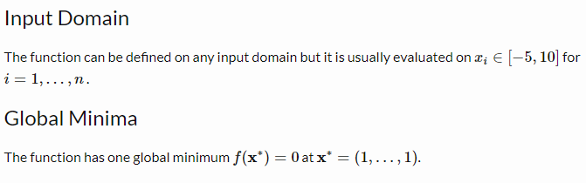
Rosenbrock Function(d = 16)

Slide 8
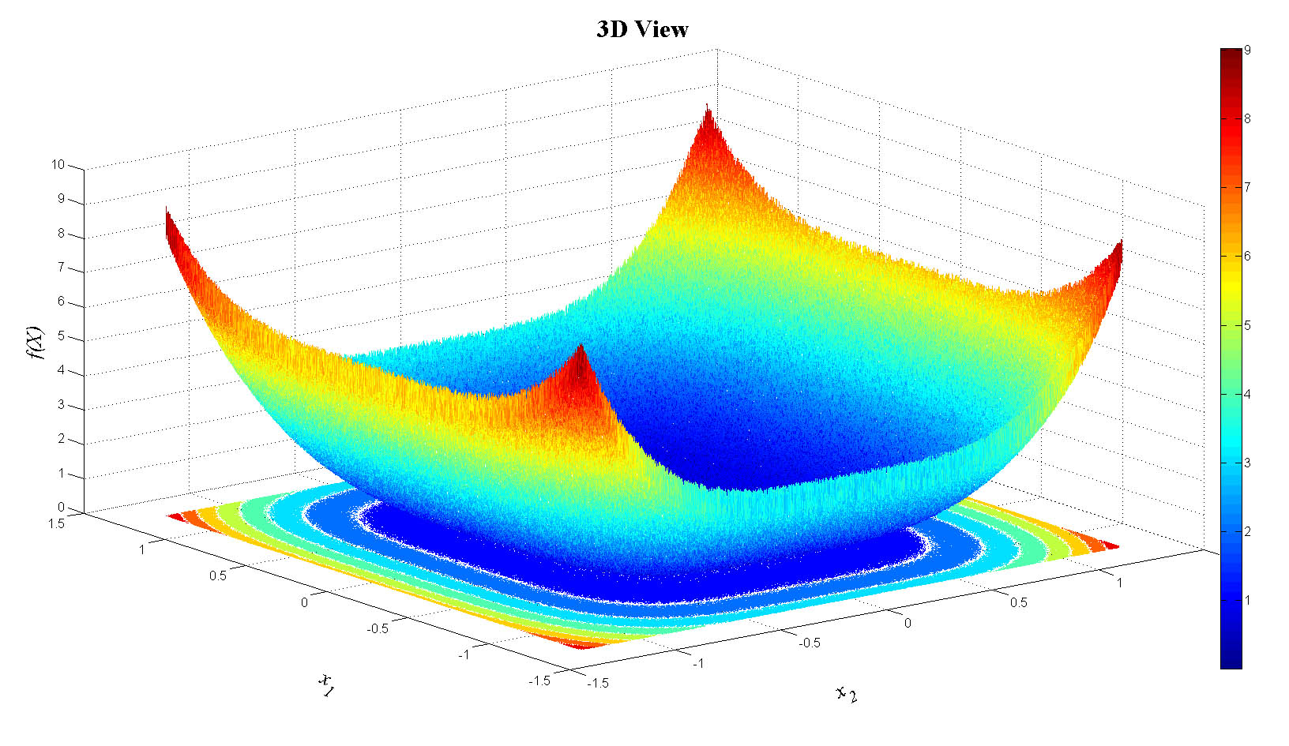
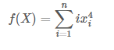
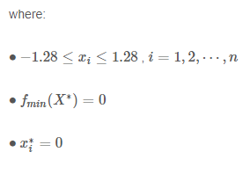
De Jong’s Quartic Function

Slide 9
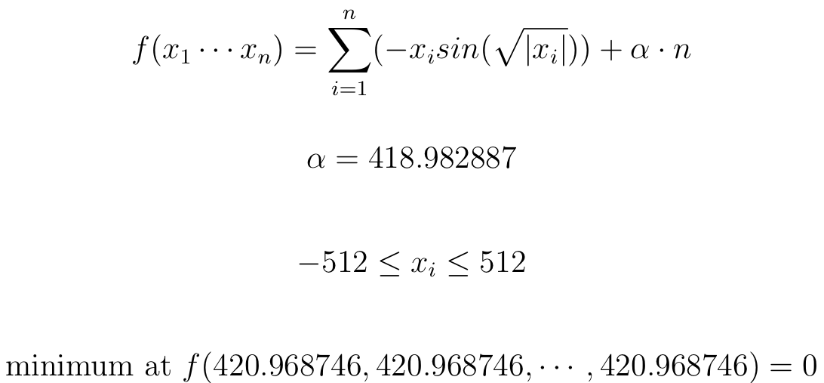
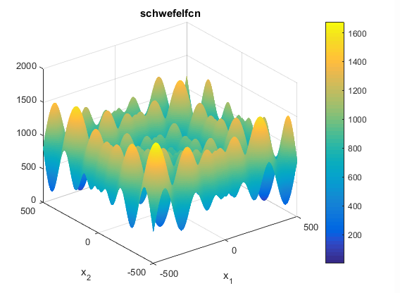
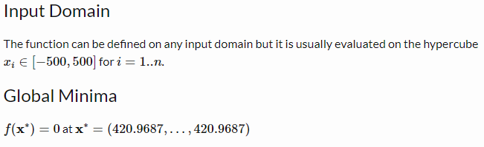
Schwefel’s Function(d=n=128)

Slide 10
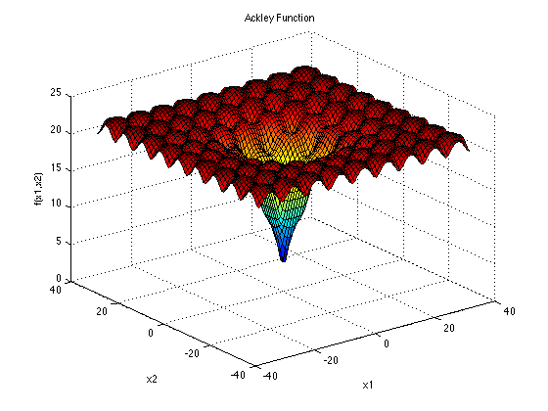
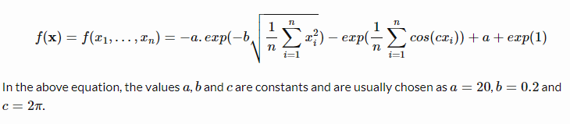
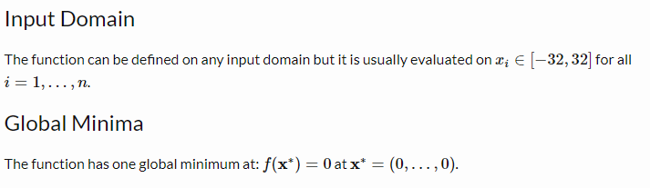
Ackley Function (d=128)

Slide 11
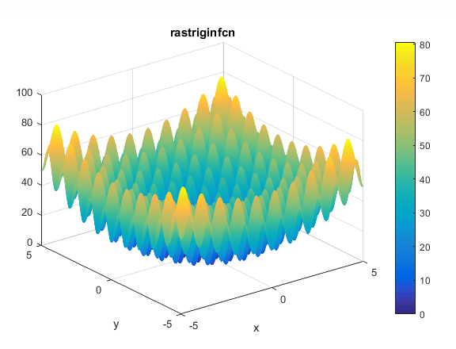
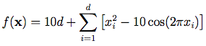
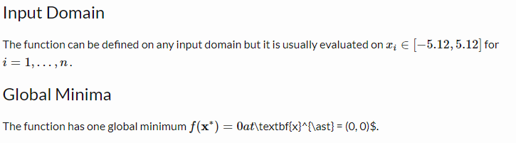
Rastrigin Function (d=128)

Slide 12
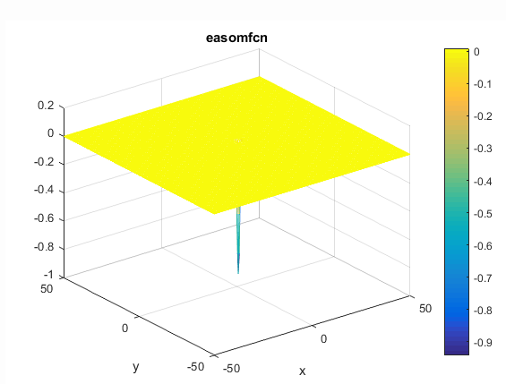
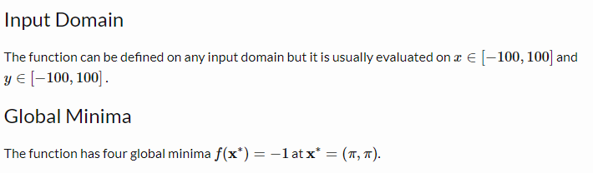
Easom Function

Slide 13
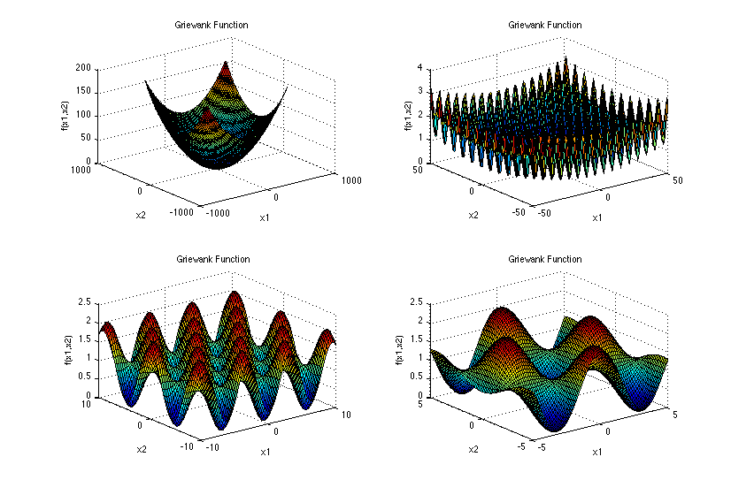
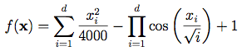
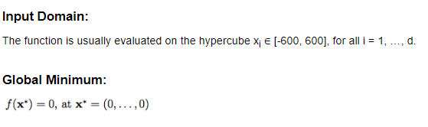
Griewank Function

Slide 14
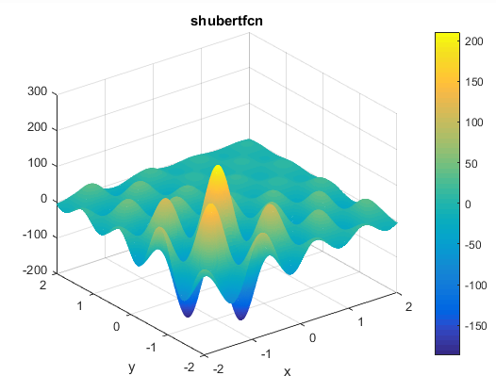
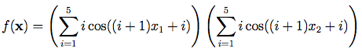
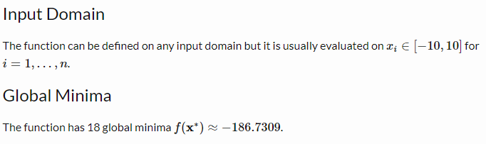
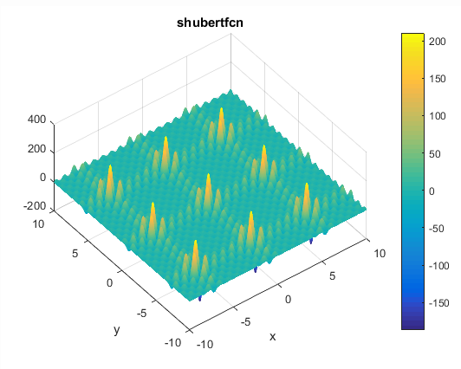
Shubert Function

Slide 15
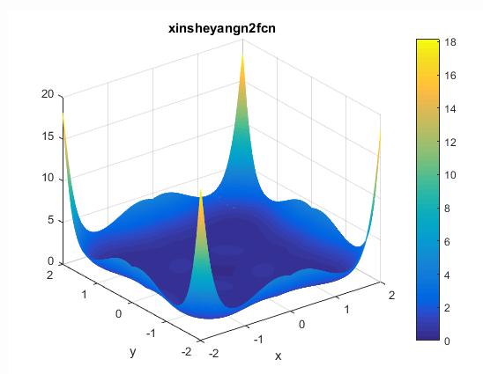
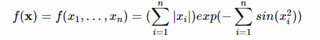
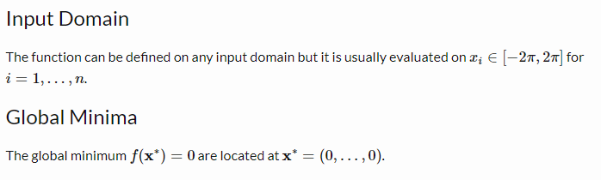
Yang’s N.2 Function (d = 16)

Slide 16
Particle Swarm Optimization
[Adapted from Pyswarm Library]
Notes:
Justify the why etc. Give a brief explanation of PSO

Slide 17
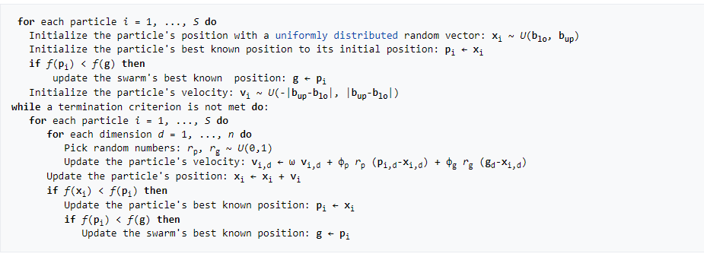
PSO

Slide 18
Firefly Algorithm
Conclusions and Results

Slide 19
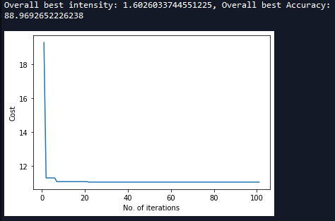
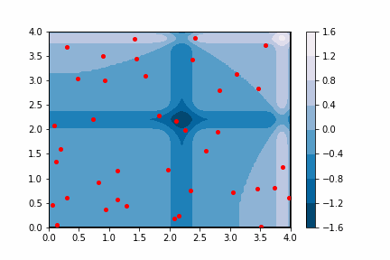
Michalewicz Function

Slide 20
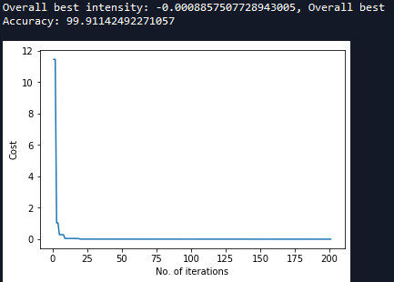
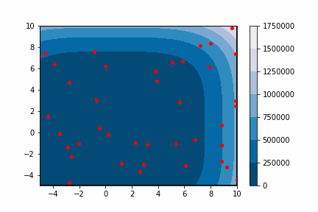
Rosenbrock Function

Slide 21
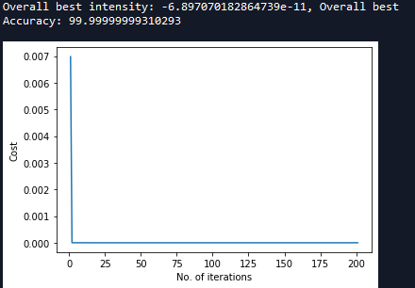
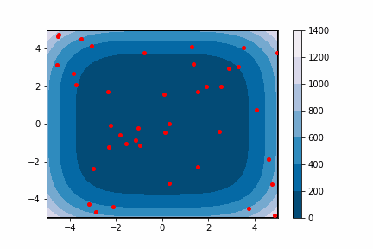
De Jong’s Function

Slide 22
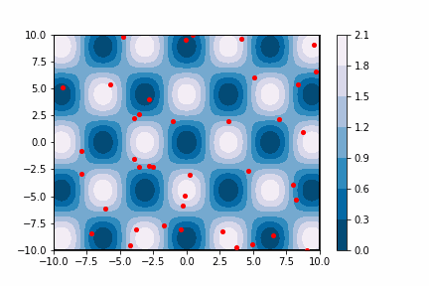
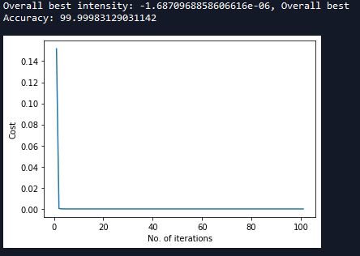
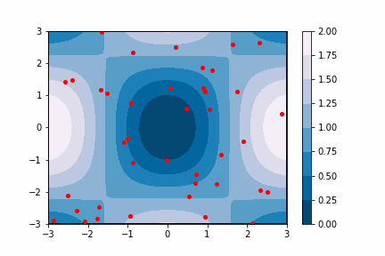
Griewank Function
Here the domain was restricted to [-3,3] for the fireflies to come to one of the global minima as there were many of them.

Slide 23
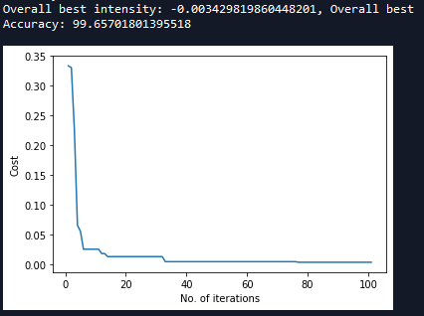
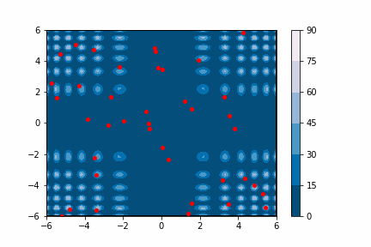
Yang N.2 Function

Slide 24
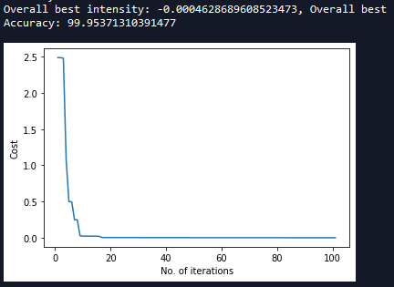
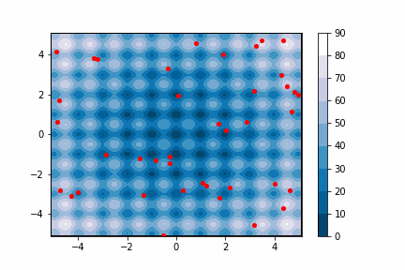
Rastrigin Function

Slide 25
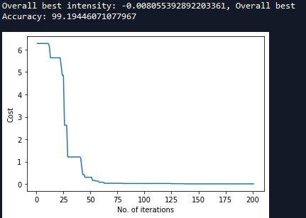
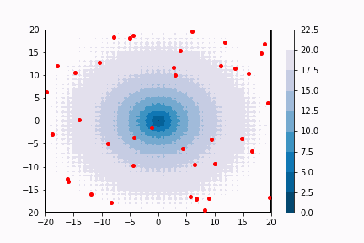
Ackley Function

Slide 26
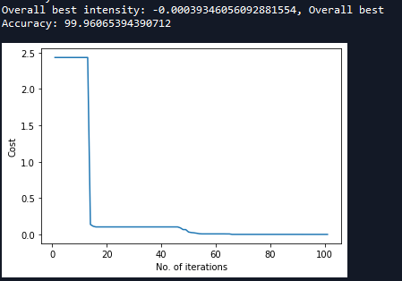
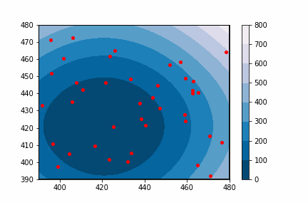
Schwefel’s Function

Slide 27


Easom Function

Slide 28


Shubert Function

Slide 29
Particle Swarm Optimization
Conclusions and Results

Slide 30


Ackley Function

Slide 31

Michalewicz Function (d=16, m=10)

Slide 32


Rastrigin

Slide 33


Rosenbrock

Slide 34


Griewank

Slide 35


Yang

Slide 36



Shubert

Slide 37

Easom

Slide 38


De Jong’s

Slide 39

Schwefel

Slide 40
Conclusion:
As the ﬁreﬂy algorithm is usually in somewhere between these two extremes, it is possible to adjust the parameter γand αso that it can outperform both the random search and PSO
FA can ﬁnd the global optima as well as all the local optima simultaneously in a very eﬀective manner.
Diﬀerent ﬁreﬂies will work almost independently, it is thus particularly suitable for parallel implementation.
It is even better than genetic algorithms and PSO because ﬁreﬂies aggregate more closely around each optimum (without jumping around as in the case of genetic algorithms).

Slide 41
Firefly V/S PSO:
Function Algorithms | Firefly | PSO
Michalewicz’s | 88.97 | 88.96
Rosenbrock’s | 99.91 | 99.45
De Jong Quartic | 100 | 100
Schwefel’s | 99.96 | 99.99
Ackley’s | 99.19 | 99.79
Rastrigin’s | 99.95 | 98.24
Easom’s | 99.99 | 99.98
Griewank’s | 100 | 99.99
Shubert’s | 99.98 | 100
Yang’s N.2 | 99.66 | 99.73

Slide 42
Thank You!

